Slide 1
Predicting Transcription Factor-DNA Binding from Sequence
CS582 Final Project – Fall 2021
Kowshika Sarker, Yasamin Tabatabaee

Slide 2
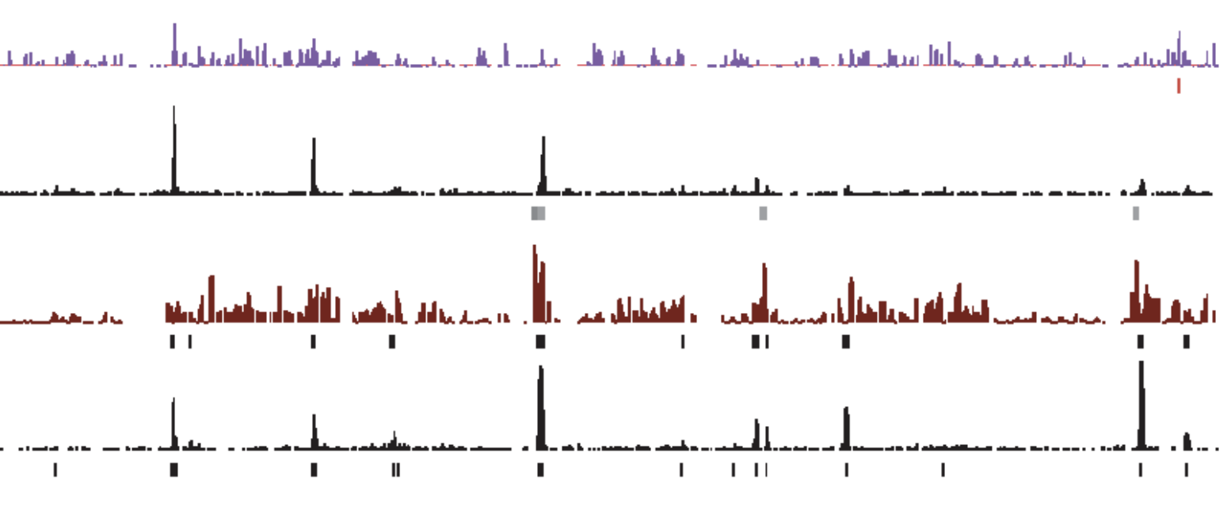
Problem Statement
The goal of this project is to predict whether a transcription factor binds to a DNA sequence
The input is segments of DNA sequence, and the output is a numeric real value that shows the binding strength
We train the model for regression and threshold on the predicted regressed value for classification
ChIP Peak
DNA Sequence

Slide 3
Dataset
Training and Test data for 26 different Transcription Factors
Input data contains sequences of length 501 of ChIP peaks and non-peaks of the TF
(train-sequence.fa, test.sequence.fa)
Output contains ChIP scores of the peaks and non-peaks that represent binding strength of the TF to the input sequence
(train-sequence.bed, test-sequence.bed)
1000 training samples and 400 test samples
Each TF has one or more PWMs known from literature or databases
(*.wtmx files)

Slide 4
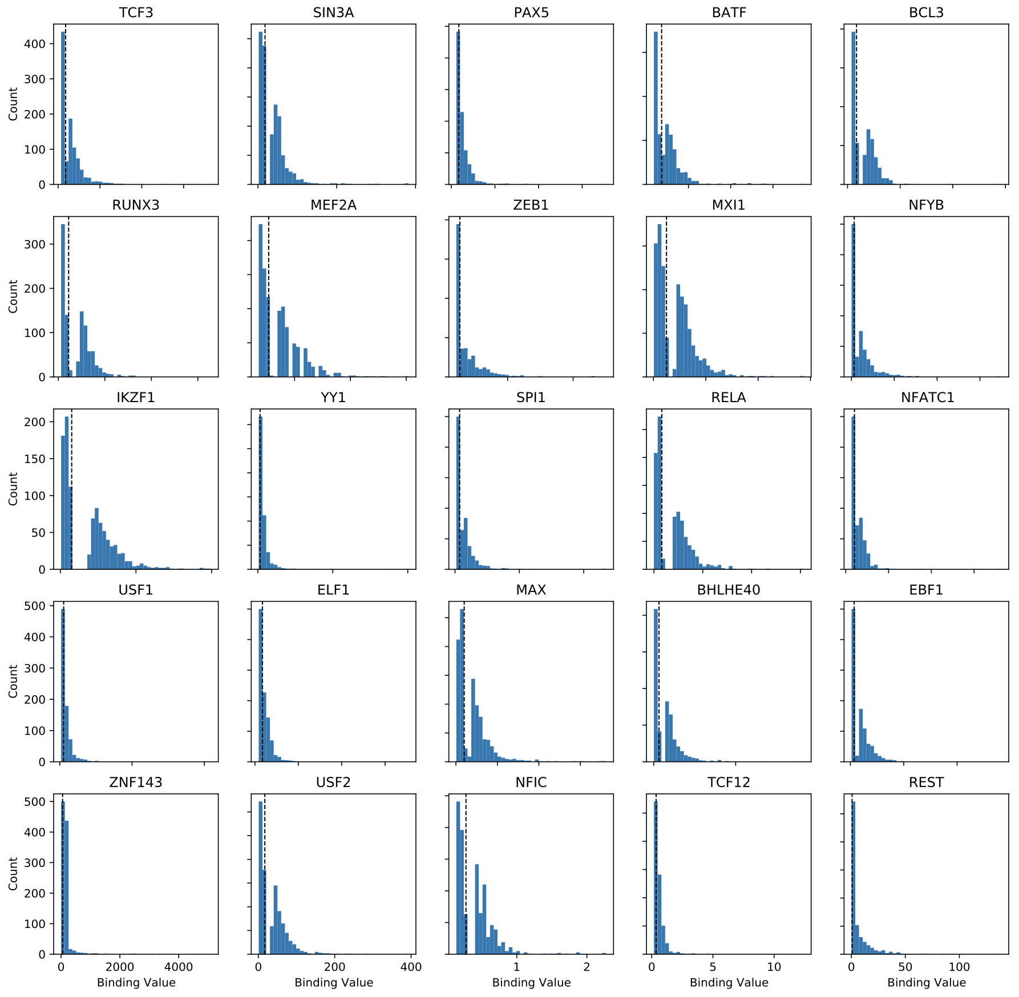
Binding Histogram
The distribution of all binding values follow a specific shape
There is a clear division (gap) between bound and un-bound values, at around the median
This threshold is used for classification task

Slide 5
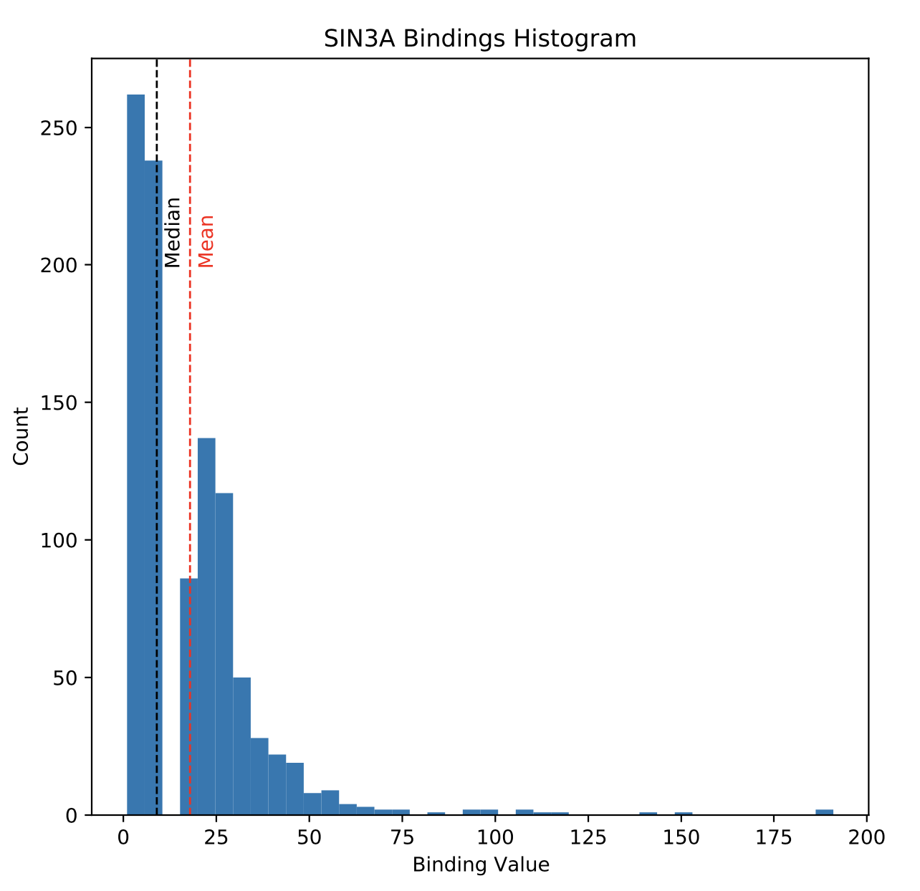
Binding Histogram (cont.)
We used median as a classification threshold when binding scores were not normalized and scaled and mean as a threshold when those were normalized

Slide 6
Outline of Methods
We implemented three different supervised learning methods
Baseline: Scoring motif matches with LLR
Per-TF: A deep learning-based model trained for each TF individually
Multi-TF: A deep learning-based model trained for all TFs simultaneously

Slide 7
Data Preprocessing
Sequences are represented with one-hot encoding
"N"s are denoted by all zero vector
Binding values have different ranges and therefore, we re-scale them to the (0, 1) range for the multi-TF model
PWMs have different lengths, and we concatenate positions to left and right of shorter PWMs so that all get the same length
Concatenated positions are base nucleotide frequency in all sequences (train and validation)

Slide 8
Evaluation Metrics
Regression
Plot of training & validation Mean-Squared Error (MSE) loss for all epochs
Test MSE
Classification
Accuracy
Sensitivity
Specificity
F1-Score
ROC-AUC
Classification is done by setting a threshold on the ChIP scores based on median or mean of the training data
Notes:
Sensitivity = TP / P = TP / (TP+FN)​
Specificity = TN / N = TN / (TN + FP)

Slide 9
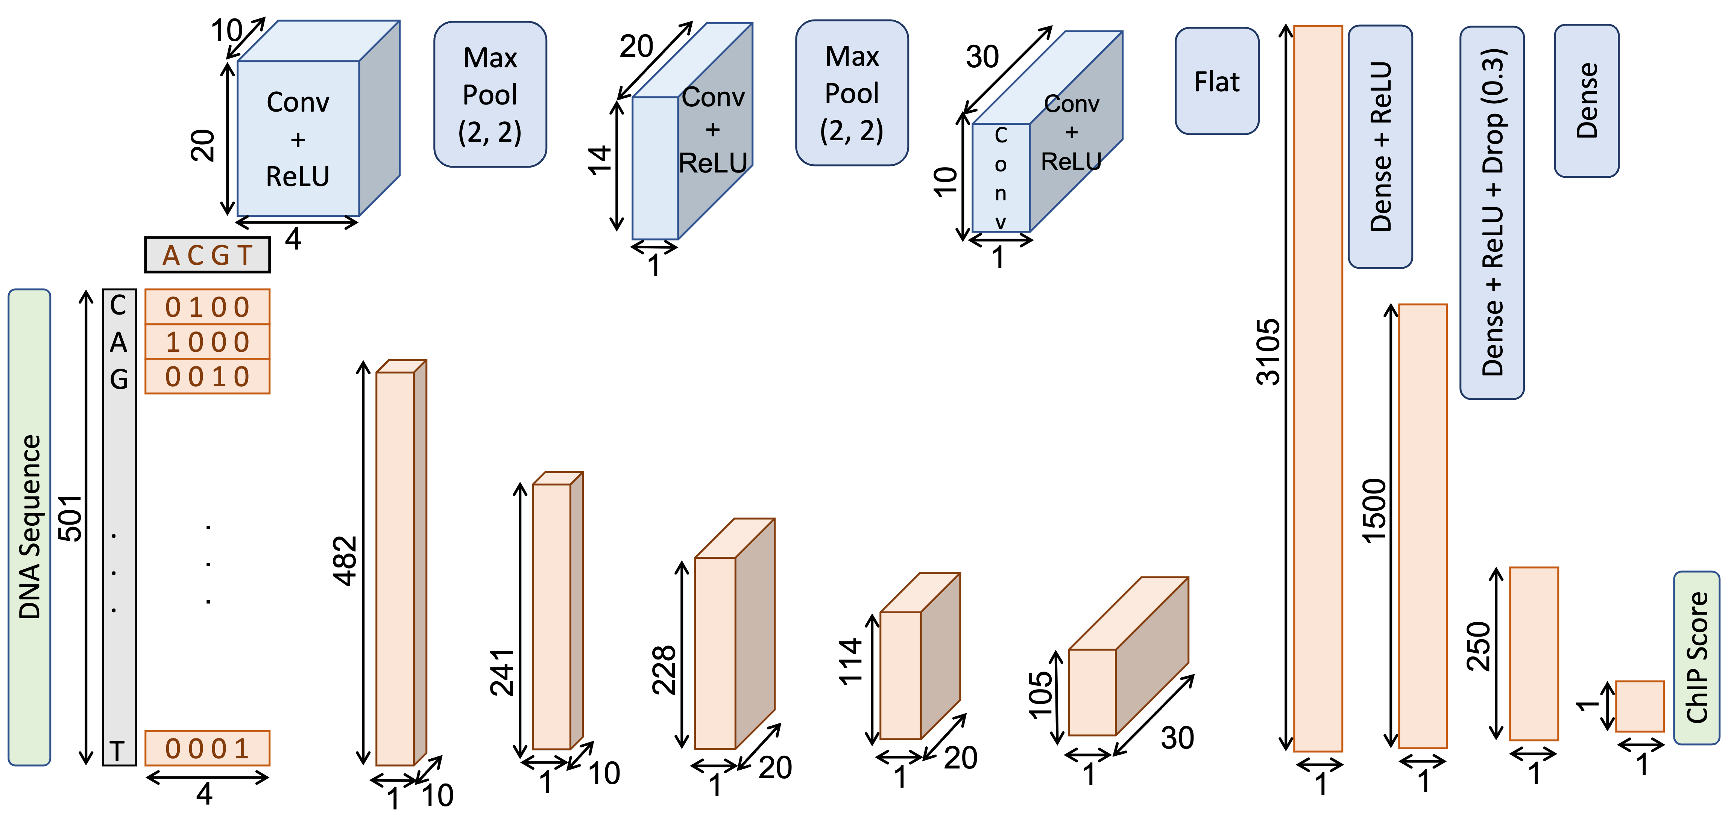
Per-TF model

Slide 10
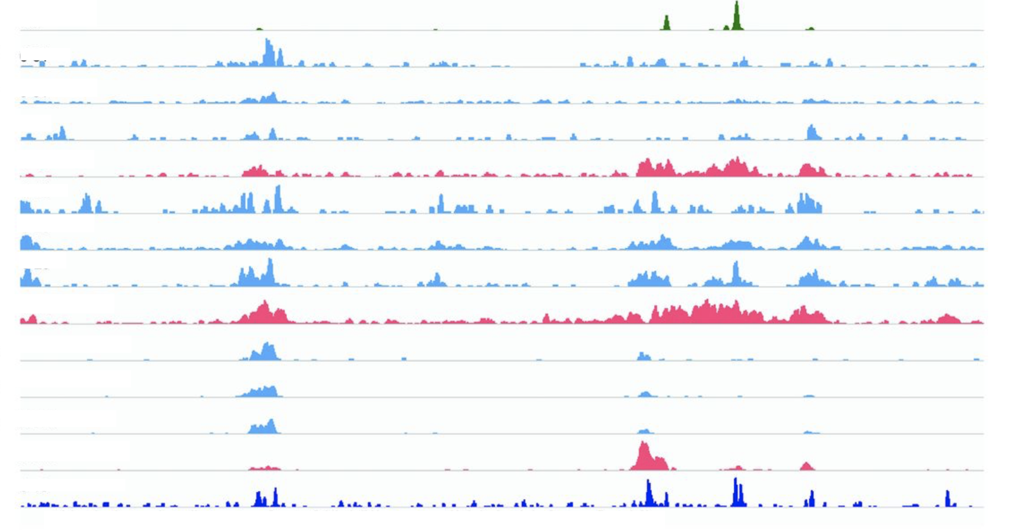
Multi-TF model
As the binding properties of the TFs might be co-related, we can train one model for all TFs, rather than a separate model for each

Slide 11
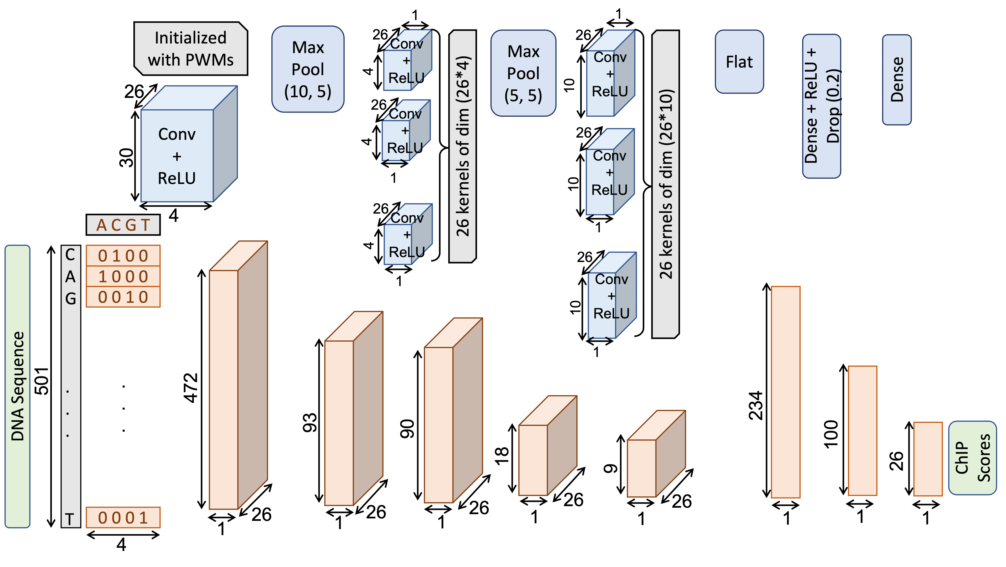
Multi-TF Model-1

Slide 12
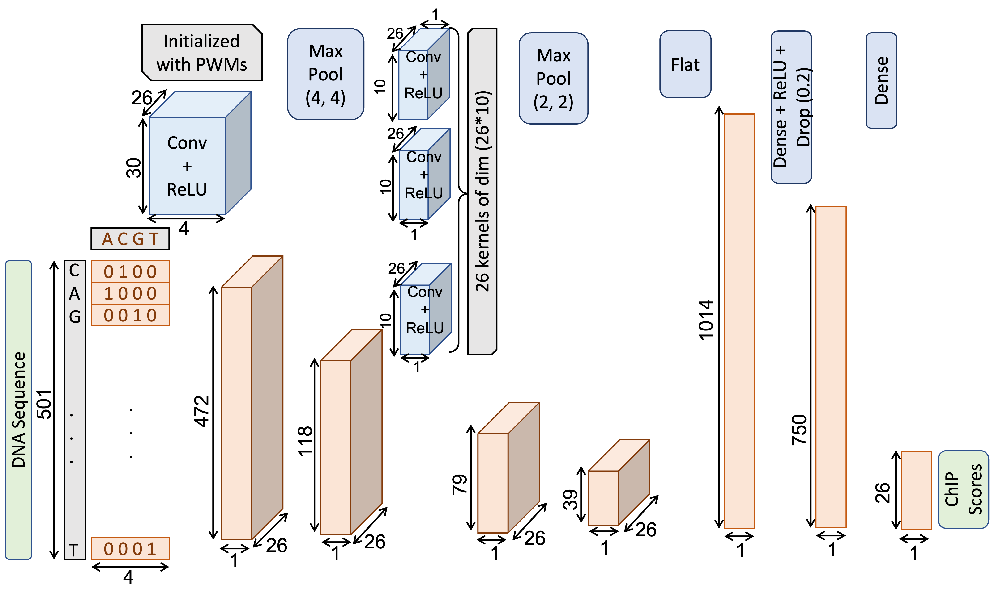
Multi-TF Model-2

Slide 13
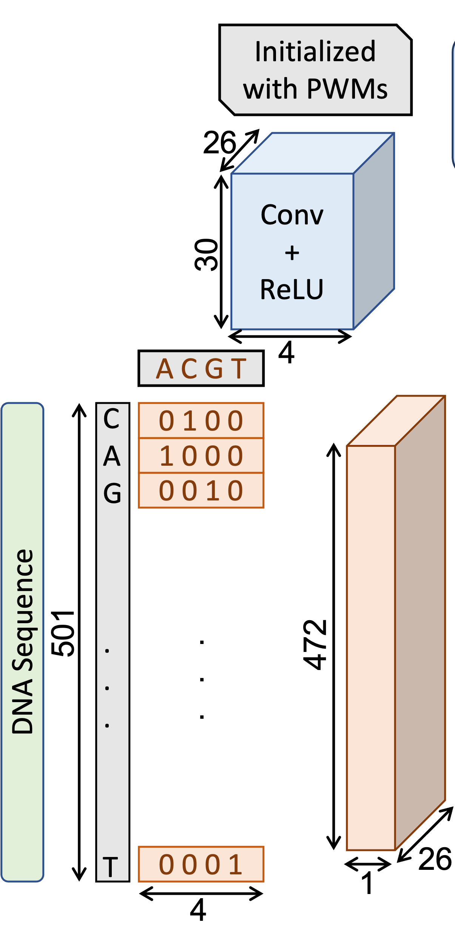
Initialized vs Learned Weights
Multi-TF model-2
Initial CNN layer -> 26 kernels of size (30*4)
Initialized with 26 PWMs
Maximum PWM length = 30
From GM12878_4.wtmx files
Shorter PWMs are left and right padded with base frequencies
Normalized nucleotide frequencies in 778 sequences
A PWM of original length 20 will be padded with 5 positions in left and right

Slide 14
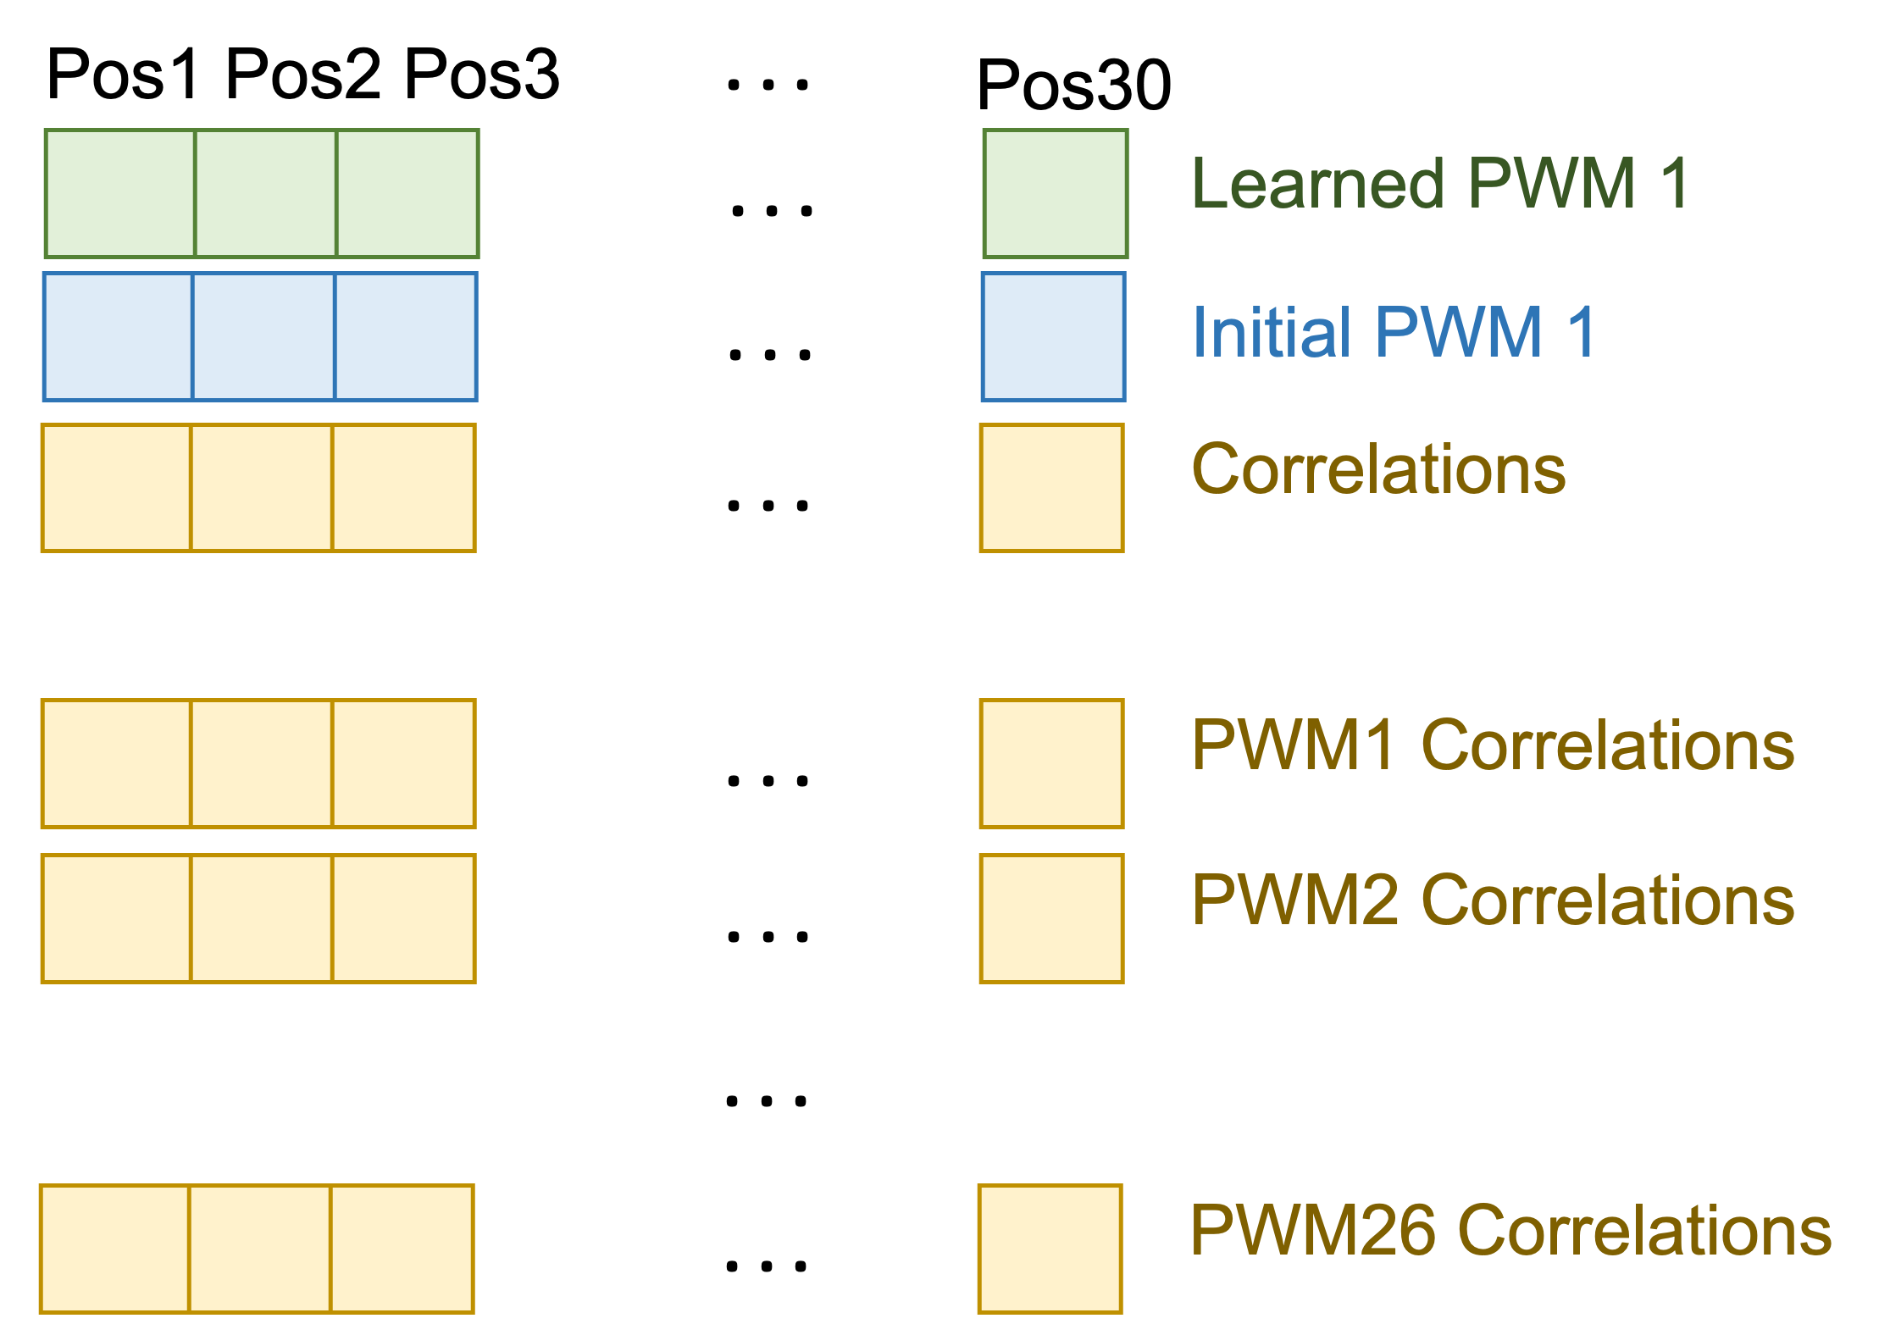
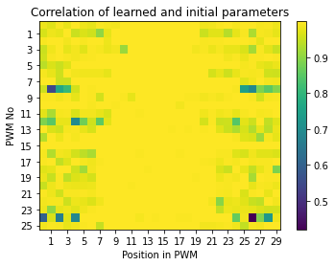
Initialized vs Learned Weights
Only non-informative weights (at leftmost and rightmost positions) change significantly during training

Slide 15
Baseline
Implemented mainly for evaluation of our deep models
For a PWM matrix W and background frequency Wb, scan a sequence Seq and find a site s for which
We computed these LLR scores for each motif of a TF
A linear regression/classification with input as max of these PWM scores and output of binding scores -> threshold
Pr(s|W)
Pr(s|Wb)
LLR(Seq, W) = max log
s € Seq

Slide 16
Training & Test Details
Train data was divided into 80% training set and 20% validation set
Train data size for per-TF models: 778-1000 samples
Train data size for per-TF models: 778 samples
Test data size for all models: 400 samples
Sequence length: 501
For DL-based models
Training batch size = 100
Learning rate = 0.0001
Criterion is MSE loss and optimization is done using Adam Optimizer

Slide 17
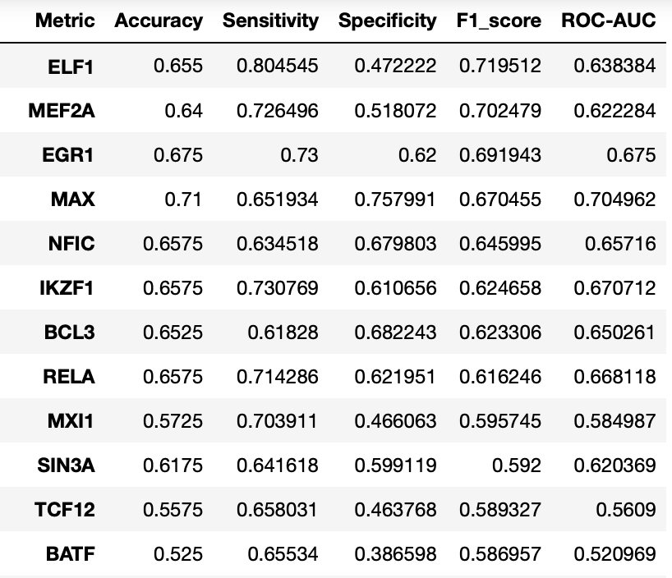
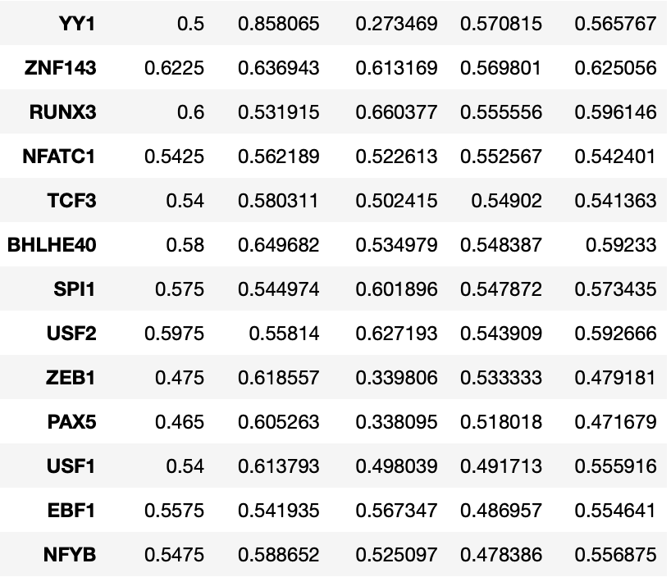
Results for Per-TF model
All metrics sorted according to F1-Score

Slide 18
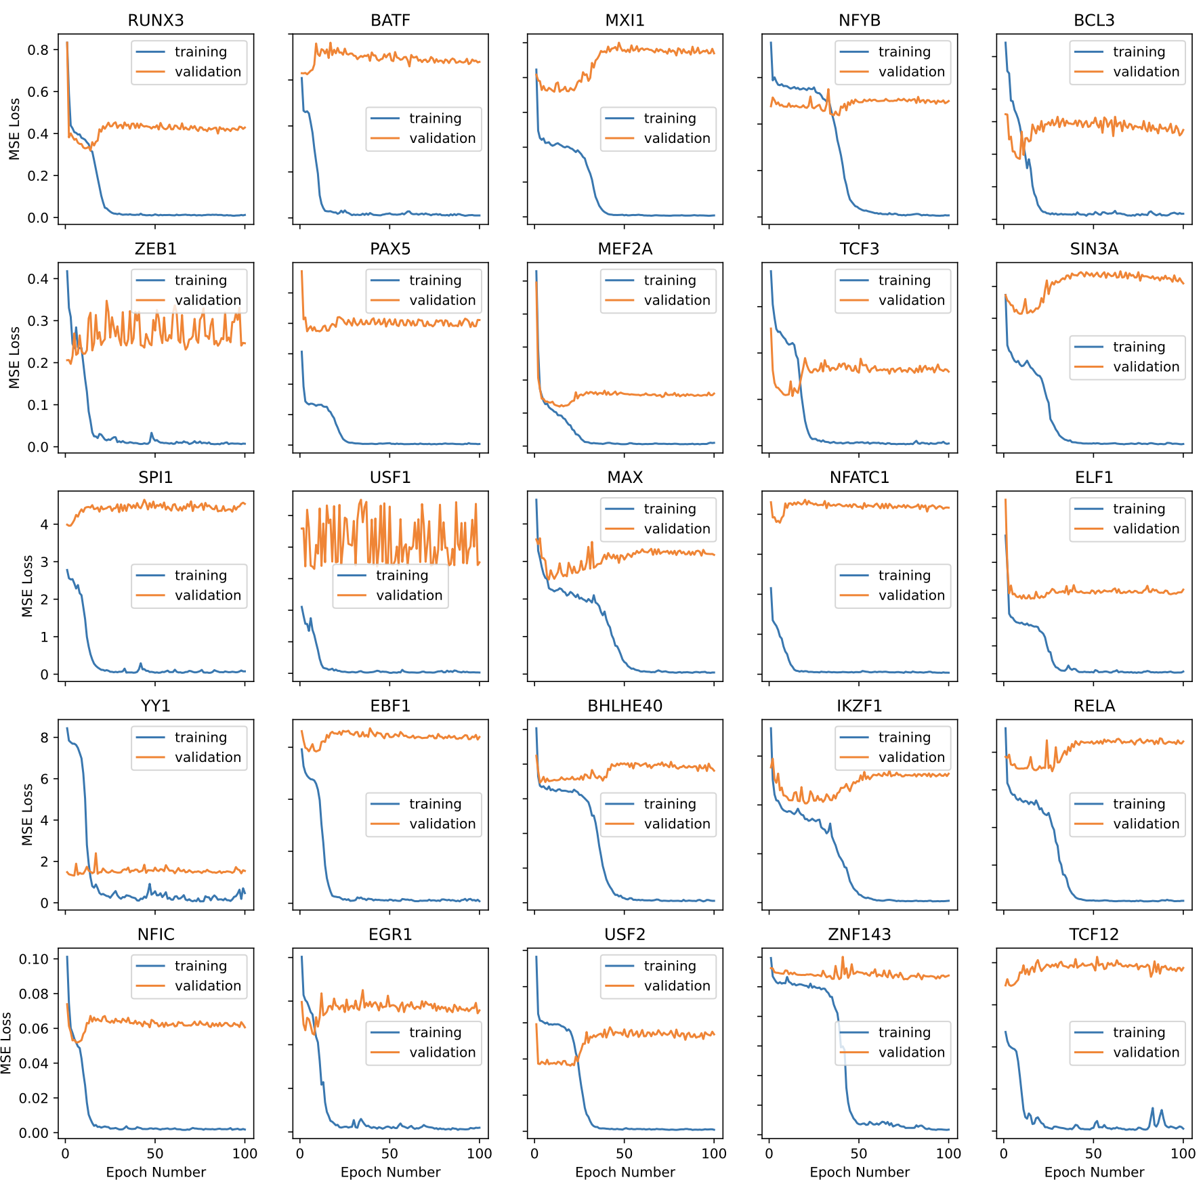
Training & Validation Loss
Most plots show over-fitting
Expected as dataset is small

Slide 19
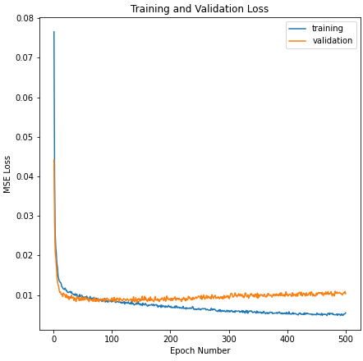
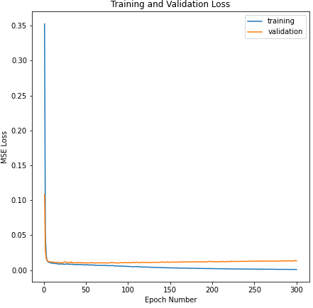
Train and Validation Loss
Overfitting similar to per-TF models
Multi-TF Model-1
Multi-TF Model-2

Slide 20
Dealing with Over-fitting
We tried several regularization methods to deal with this over-fitting, but the results were generally the same
Dropout layers
Batch normalization
Reducing no. of layers and/or no. of elements per layer
L1 and L2 regularization
We conclude that the main cause of this overfitting might be the small size of the training dataset given the complexity of DL-based models

Slide 21
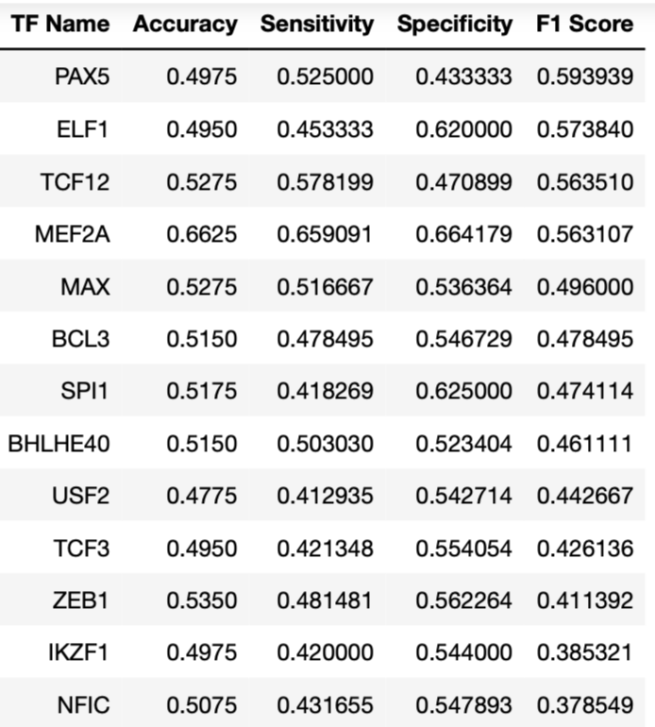
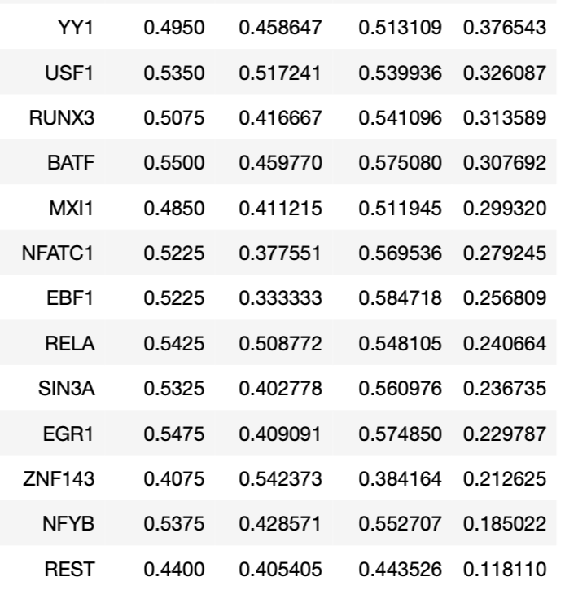
Results for Multi-TF Model-1

Slide 22
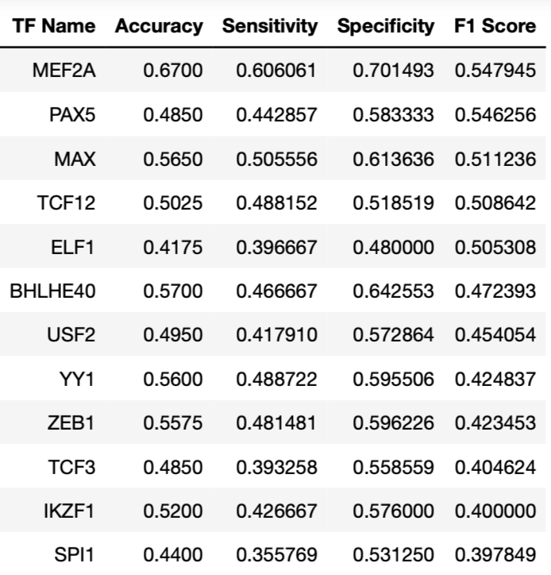
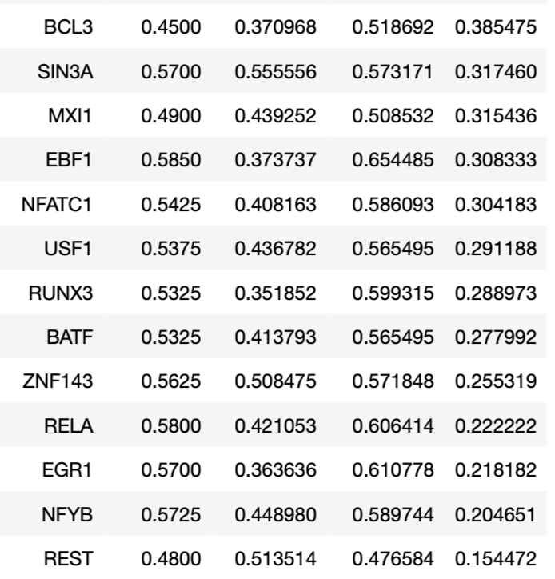
Results for Multi-TF Model-2

Slide 23
Inter-TF Correlation
Each TF: 1d vector of length 778
Binding scores in 778 sequences
Pearson correlation coefficients for ²⁶C₂ (= 325) TF pairs
174 pairs are negatively correlated
Lowest magnitude of correlation: 0.0001717 (BATF: EFB1)
Highest magnitude of correlation: 0.16863949 (MXI1: NFATC1)
Multi-TF models sometimes perform better and sometimes worse than per-TF models
As TF pairs are not significantly correlated, codependence in multi-TF models probably is disrupting original signals

Slide 24
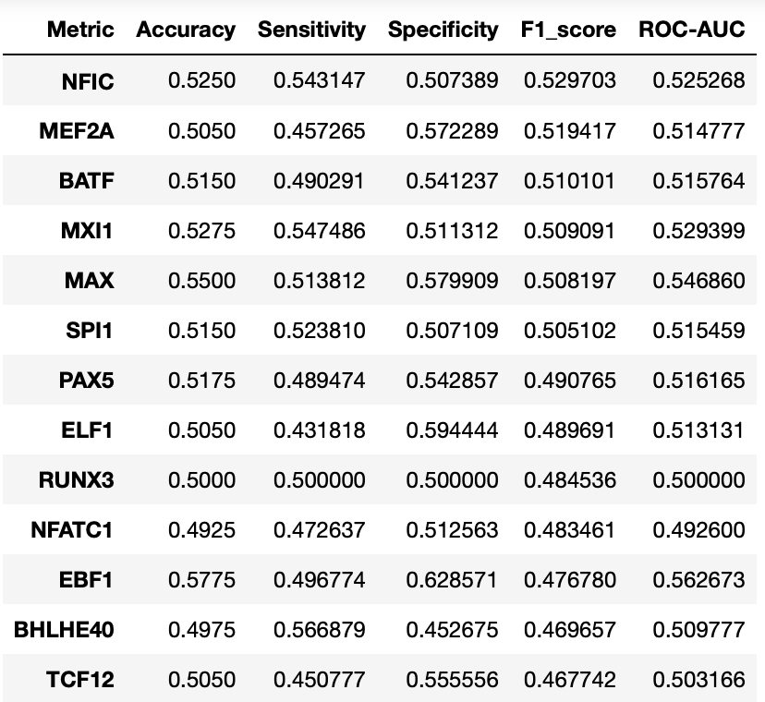
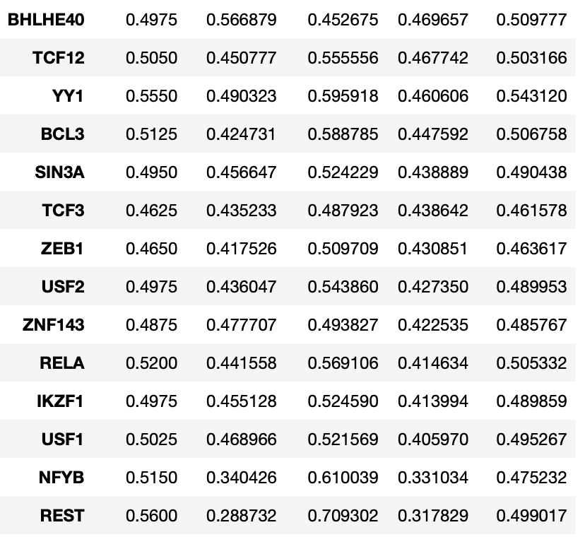
Results for Baseline
All metrics sorted according to F1-Score

Slide 25
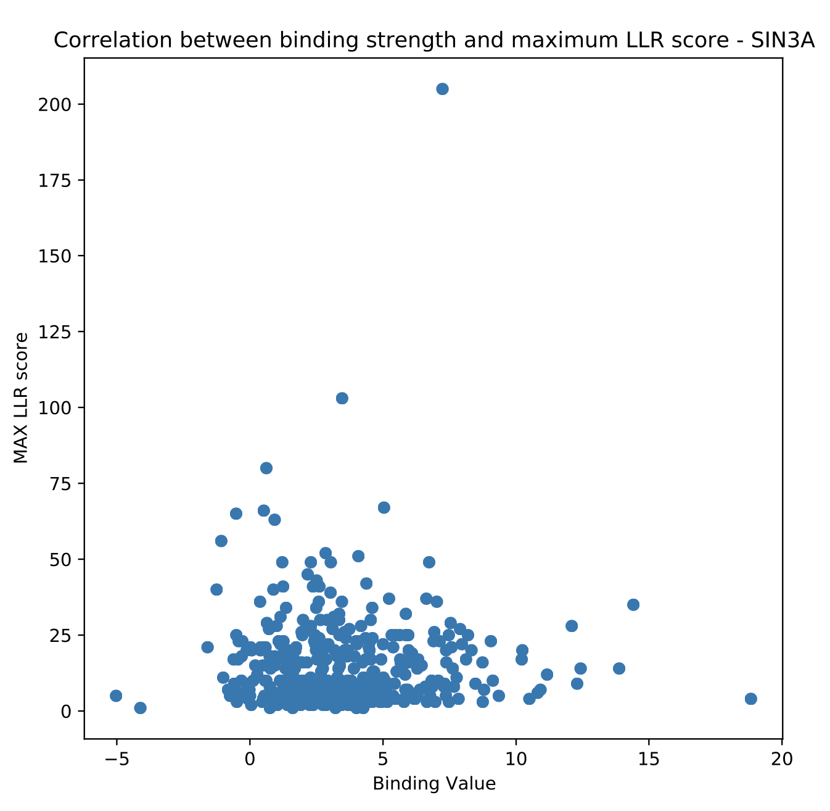
PWM Score and Binding Score Correlation
There are no apparent correlations between LLR scores and binding strengths
This might be the reason behind Baseline's poor performance

Slide 26
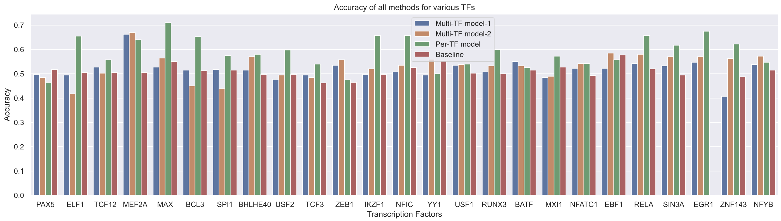
Method Comparison

Slide 27
Conclusions
We can see that the Per-TF model has the best overall performance
The Multi-TF model's weaker performance is likely due to low correlation between TFs and small data size
None of the deep models have a very high accuracy, likely due to small training set size
The Per-TF models almost always work better than the baseline and the multi-TF models sometimes work better than the baseline
So, despite overfitting, which means a deep learning-based model can be more effective than using PWM scores only

Slide 28
References
Predicting effects of noncoding variants with deep learning–based sequence model (https://www.nature.com/articles/nmeth.3547)

